Slide 1




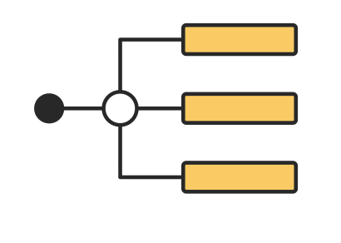
EXPERIENCE PROTOTYPES
Team Name: JAMJ, (Jonah Blaydes-Greenberg, Alex Yansouni, Meghana Paturu, Jennifer Lew)

Slide 2

CONTENTS
01
Where Were We?
02
Additional Needfinding
03
From HMWs to Solutions
04
Our Solutions
05
What’s Next?

Slide 3





Meet the Team!
Jennifer Lew (’26) Computer Science (AI) Palos Verdes, CA
Alex Yansouni (’26) Computer Science (HCI) Los Altos, CA
Meghana Paturu (’26) Computer Science (HCI) & Economics Belle Mead, NJ
Jonah Blaydes-Greenberg (’26) Computer Science (HCI) & Music Los Altos, CA

Slide 4

01
WHERE WERE WE?

Slide 5

LAST WEEK’S FINDINGS
Qualified, helpful TAs are often regarded by students as too scarce to be worth seeking out time with
The TA recruitment process is rigorous and TAs are underpaid
CHANGE IN SCOPE
Improving school-provided in-person resources or finding them somewhere else
Resources for TAs and students

Slide 6
LAST WEEK’S POVs
Game Changing to outsource in-person learning beyond a school’s faculty and TAs
We met “Alan Turing,” a hard-working high school student in the Bay Area.
We were surprised to realize that he chooses to get help from teachers in office hours as much as possible, but finds that their availability has dwindled and it’s difficult to find help from teachers or other students without personal connections.
We wonder if this means that people would be more engaged in the learning process if they were getting help from other students with experience with that content.
It would be game-changing to outsource in-person learning beyond a school’s faculty and TAs.
We met “Grace Hopper”, a current college junior at USC studying pre law, who previously attended UCSC and community college
We were surprised to realize that she preferred to work with peers who are knowledgeable of the class than TAs
We wonder if this means that she feels discouraged and unsure by the academic support system and makes her feel to be less motivated in doing work.
It would be game-changing to connect capable students and students in need of academic support.
Game Changing to connect capable students and students in need of academic support

Slide 7
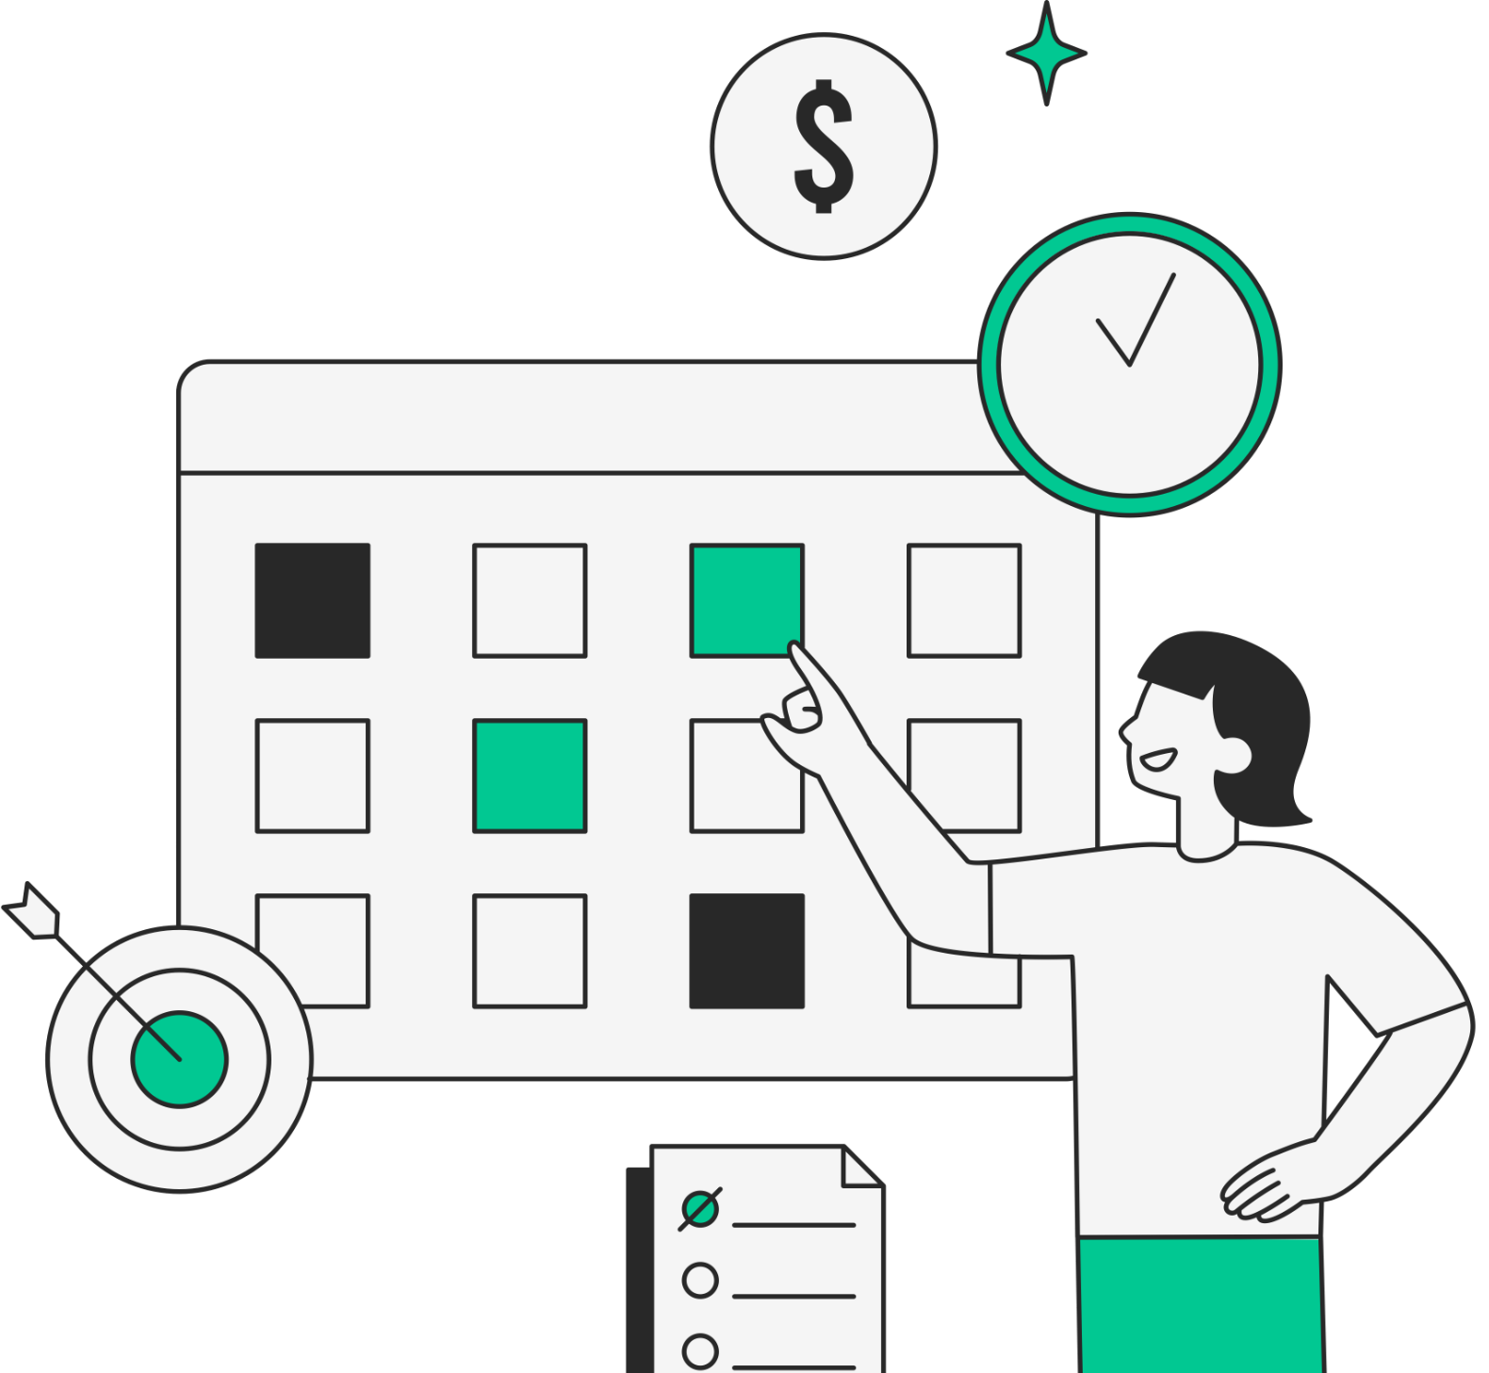
02
ADDITIONAL NEEDFINDING

Slide 8


ADDITIONAL NEEDFINDING
New Learnings:
Limited personalized support in large STEM classes leads students to rely on AI tools for assistance.
Need for flexible learning resources that support both students and educators.
Academic freedom for educators could greatly improve student engagement + outcomes.
“Sam Altman”
“James Gosling”
UCSB Graduate
Acquaintance
Compensation: Jamba Juice
Teacher and Freelance Tutor
Acquaintance

Slide 9
NEW POV #1: “SAM ALTMAN”
We are surprised to notice that introductory STEM classes at his school were intentionally made difficult enough to discourage people from pursuing specific majors and that the learning resources provided were either scarce, redundant, or irrelevant.
We met with “Sam Altman,” a recent UCSB graduate who used AI tools extensively in his learning process.
We wonder if this means that “Sam’s” eventual reliance on AI resulted from a lack of personalized help from a school incentivized not to provide any.
It would be game-changing to create learning resources that help students seek in-person help to reduce the appeal of cheating with AI

Slide 10
How might we democratize peer tutoring so that every student has equal access to personalized help?
How might we redesign a 2000-person lecture to be more engaging and personalized?
How might we design STEM courses that balance difficulty with support, so students are challenged but not overwhelmed?
How might we make student support systems more flexible, addressing everyone's needs without slowing down advanced students?
How might we reduce the over-reliance on AI tools by improving the accessibility and quality of in-person academic support?
How might we incentivize tutors to help with the learning process rather than just provide answers?
How might we ensure that TAs at office hours have time to teach the content rather than simply giving answers?
How might we introduce peer-assisted study sessions in large classes to promote active, group-based learning?
How might we create AI-driven tools that encourage collaboration and learning rather than shortcutting?
How might we make lecture content more relevant and applicable to real-world problems to reduce reliance on AI tools?
How might we increase collaboration among students in large lectures to foster community and shared learning responsibility?
How might we create transparency and accountability for students who rely heavily on AI tools in their learning process?
How might we design learning resources that are more interactive and adaptable to individual students’ needs?

Slide 11

NEW POV #2: “ADA LOVELACE”
We were surprised to notice how long and rigorous the hiring process is, yet it lacks proper training for those selected to become TAs.
We met with “Ada Lovelace,” a full-time TA and Edtech Researcher at Stanford University, who has gone through the extensive process of becoming a TA.
It would be game-changing to create a standardized system to prevent bias in hiring TAs and streamline the process, giving more people the opportunity to receive proper training and teach in a less rigid way.
We wonder if this means that many potential candidates are excluded because they don't fit into the narrow criteria required to complete the process.

Slide 12
How might we develop a standardized training program for TAs?
How might we make the TA hiring process more accessible to a diverse range of candidates?
How might we prevent tunnel vision and ensure flexibility in the TA selection process?
How might we streamline the hiring process for TAs to reduce bias?
How might we ensure proper training for TAs to increase their effectiveness?
How might we create a more inclusive and supportive environment for prospective TAs during hiring?
How might we reduce the time and effort required in the TA hiring process without compromising quality?
How might we use technology to assist in a fair and efficient TA selection process?
How might we redesign the TA hiring process to include both technical skills and teaching abilities?
How might we ensure continuous feedback and support for TAs during and after their hiring process?
How might we make the TA hiring process adaptable to different departments' specific needs?

Slide 13
NEW POV #3: “JAMES GOSLING”
We met with James Gosling, a freelance tutor, who formerly taught English at high school, community college, and private college
We were surprised to notice how restricted he felt by the lack of academic freedom in traditional institutions, where bureaucracy and rigid expectations limited his ability to teach effectively and connect with students.
We wonder if this means that many educators, especially junior faculty, are stifled by these institutional constraints, preventing them from exploring more dynamic and impactful teaching methods.
Game-changing to create an environment that promotes true academic freedom, allowing educators the liberty to teach in ways that foster deeper student engagement and accountability, without being bound by outdated structures and expectations.

Slide 14
How might we develop a rating and review system that helps students find the most effective tutors based on teaching quality?
How might we allow tutors to customize their teaching approach to meet students' needs, breaking free from institutional constraints?
How might we create a platform where educators can freely offer tutoring without institutional bureaucracy?
How might we make the process of finding and booking a tutor as easy and seamless as booking an Uber?
How might we create a marketplace where tutors can showcase their expertise and connect with students who need help?
How might we develop a platform that offers both virtual and in-person tutoring options to accommodate different learning preferences?
How might we provide flexible tutoring options that allow educators to set their own schedule and rates?
How might we empower junior faculty or aspiring educators to gain valuable teaching experience while tutoring?
How might we leverage technology to create personalized learning experiences based on a student’s needs and goals?
How might we make one-on-one tutoring more accessible to students with varying academic and financial needs?

Slide 15

03
FROM HMWs TO SOLUTIONS

Slide 16
HMW #1:
How might we ensure that TAs at office hours have time to teach the content rather than simply giving answers?
from “Sam Altman’s” POV

Slide 17
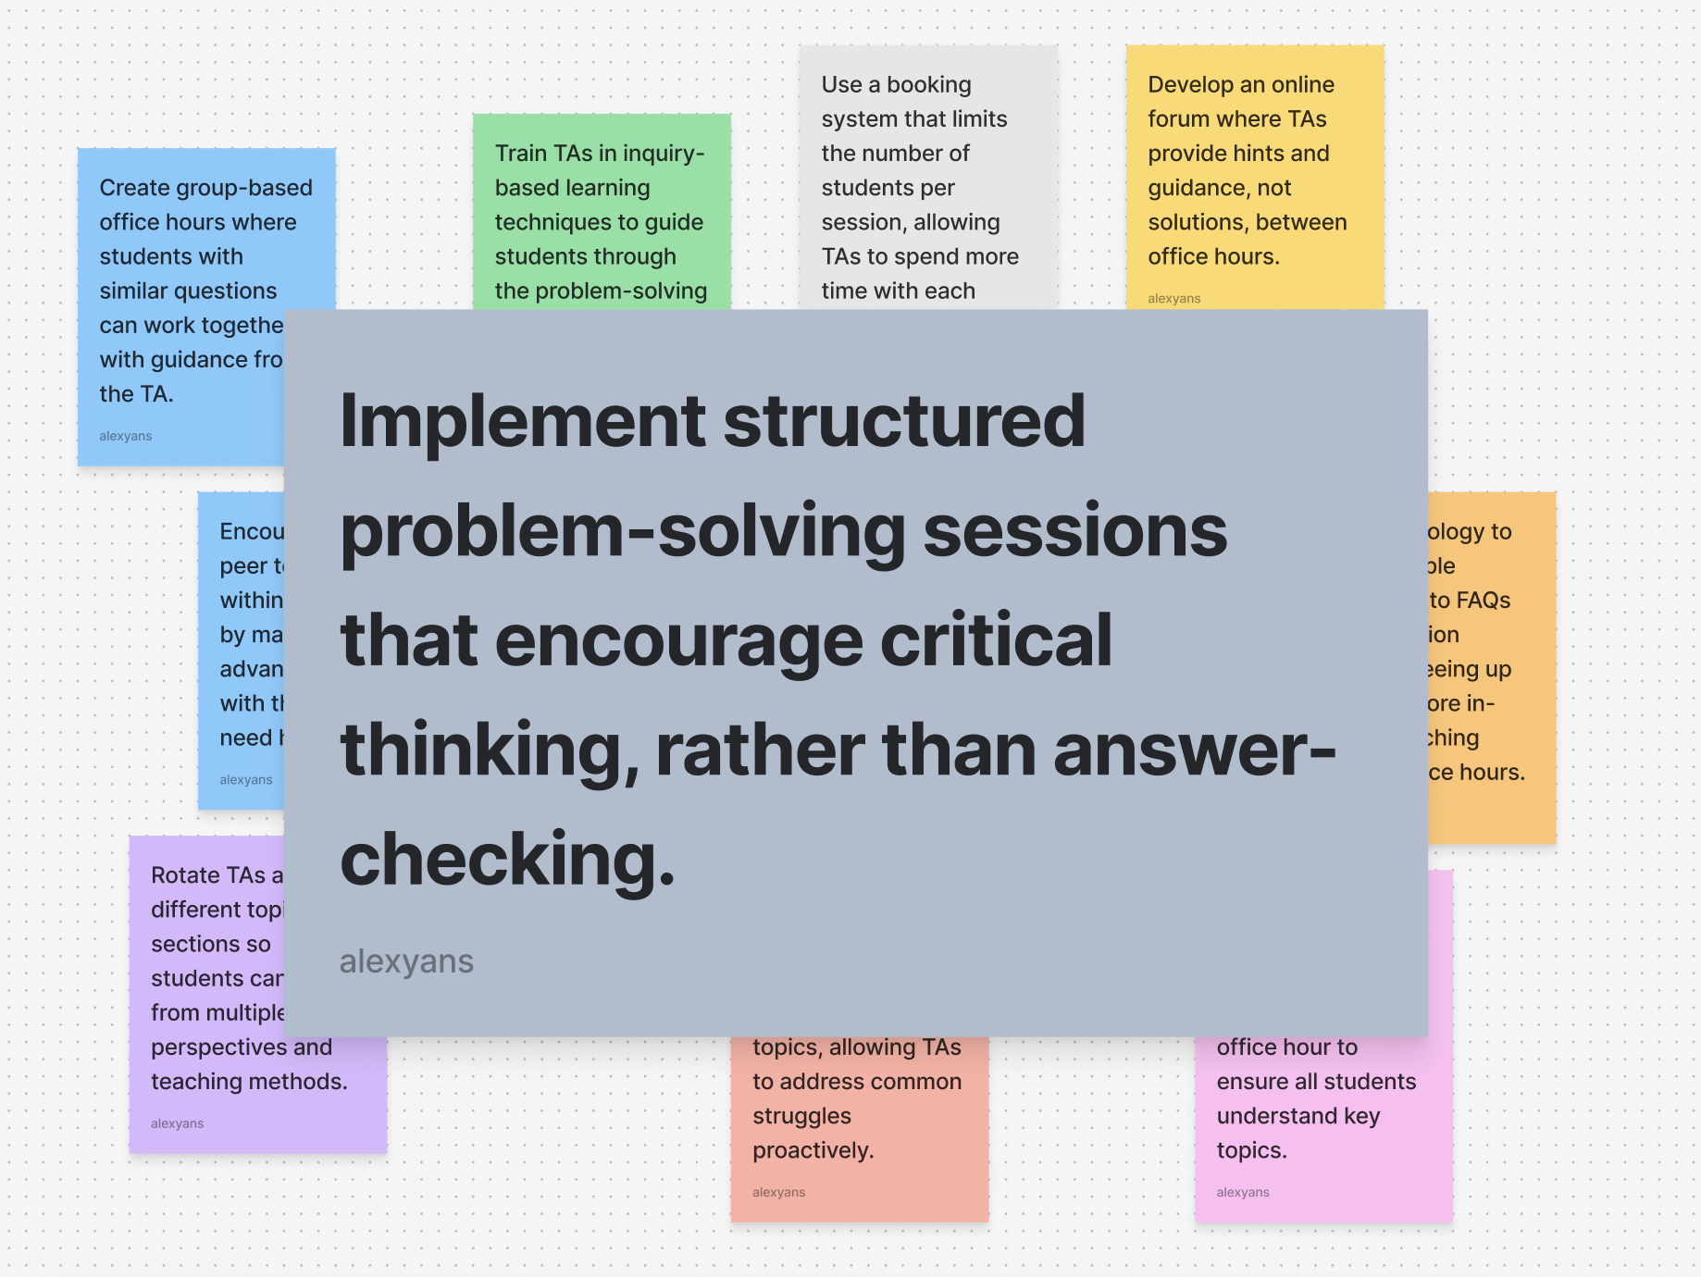
Solution Idea 1

Slide 18
HMW #2:
How might we ensure proper training for TAs to increase their effectiveness?
from “Ada Lovelace’s” POV

Slide 19
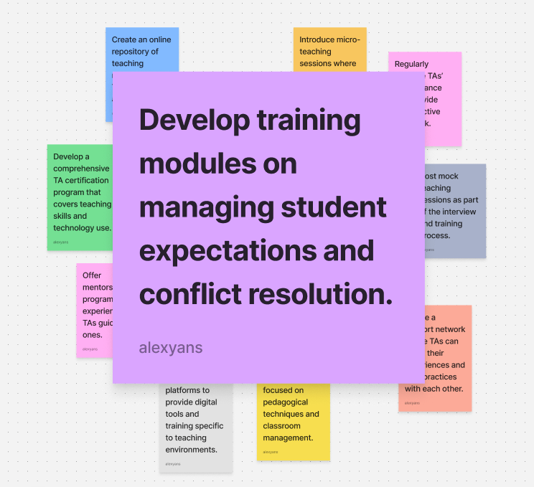
Solution Idea 2

Slide 20
HMW #3:
How might we make the process of finding and booking a tutor as easy and seamless as booking an Uber?
from “James Gosling’s” POV

Slide 21
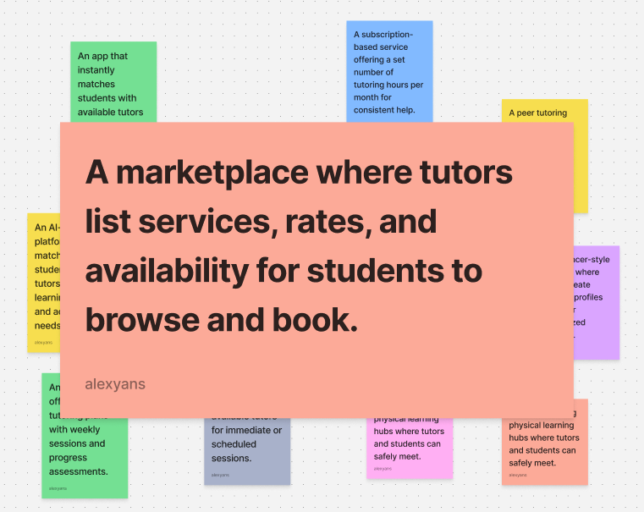
Solution Idea 3

Slide 22

04
OUR SOLUTIONS

Slide 23



PROTOTYPE 1: GROUP LEARNING SESSIONS
Grouping students with similar questions into small, teacher-assigned groups.
Encourages peer learning while TAs facilitate critical thinking
A collaborative environment fosters deeper understanding and encourages active participation.
Concept
Critical Assumption
Format
Used a form to survey students’ experience with class content and form study groups based on responses

Slide 24
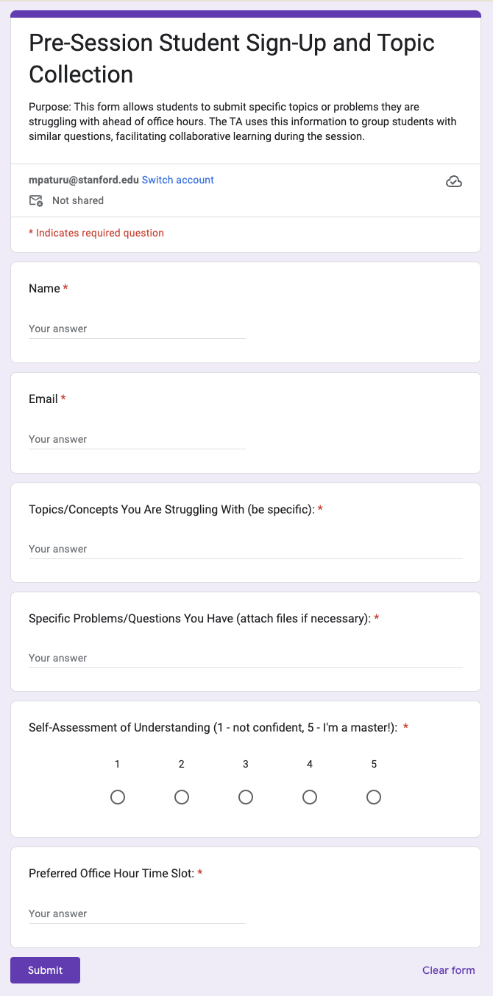
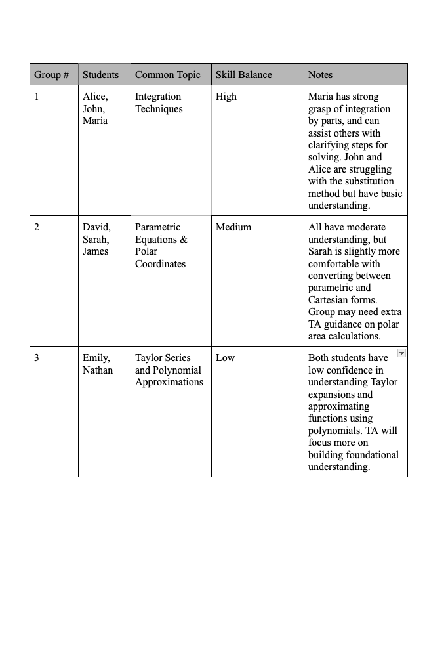
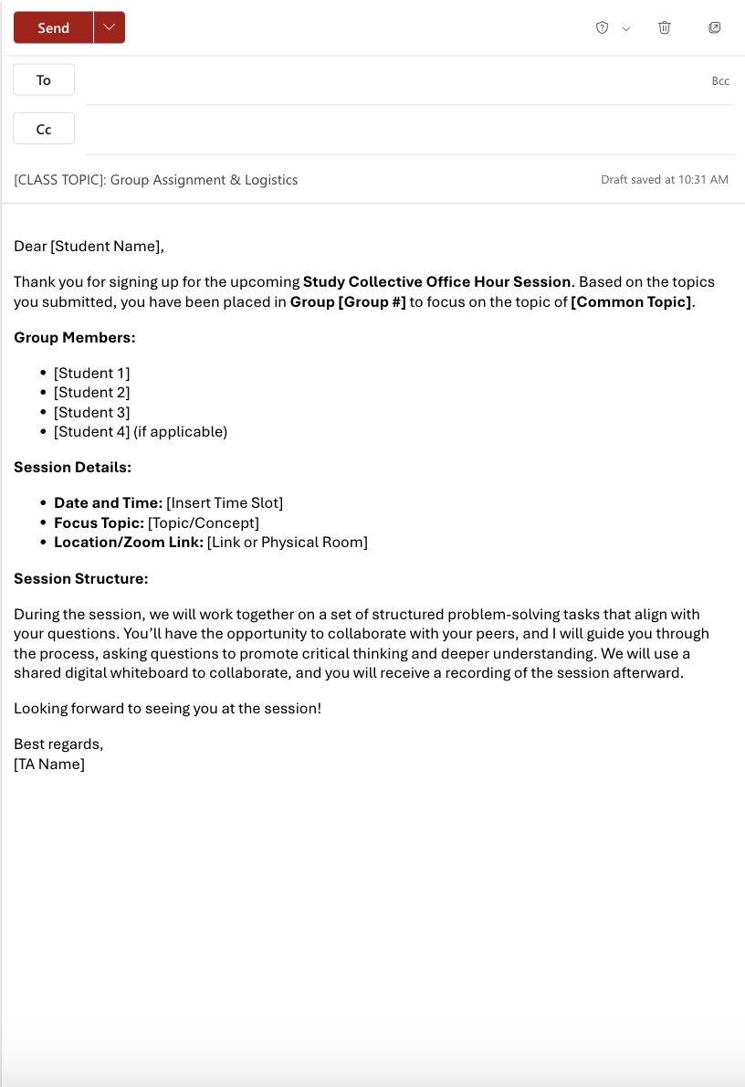
Step 1: Pre-Session Student Sign-Up and Topic Collection
Step 2: Dynamic Group Formation Based on Topics and Comfort Level with Content - INTERNAL USE
Step 3: Notify Students of Group Assignments and Session Structure - TEMPLATE

Slide 25
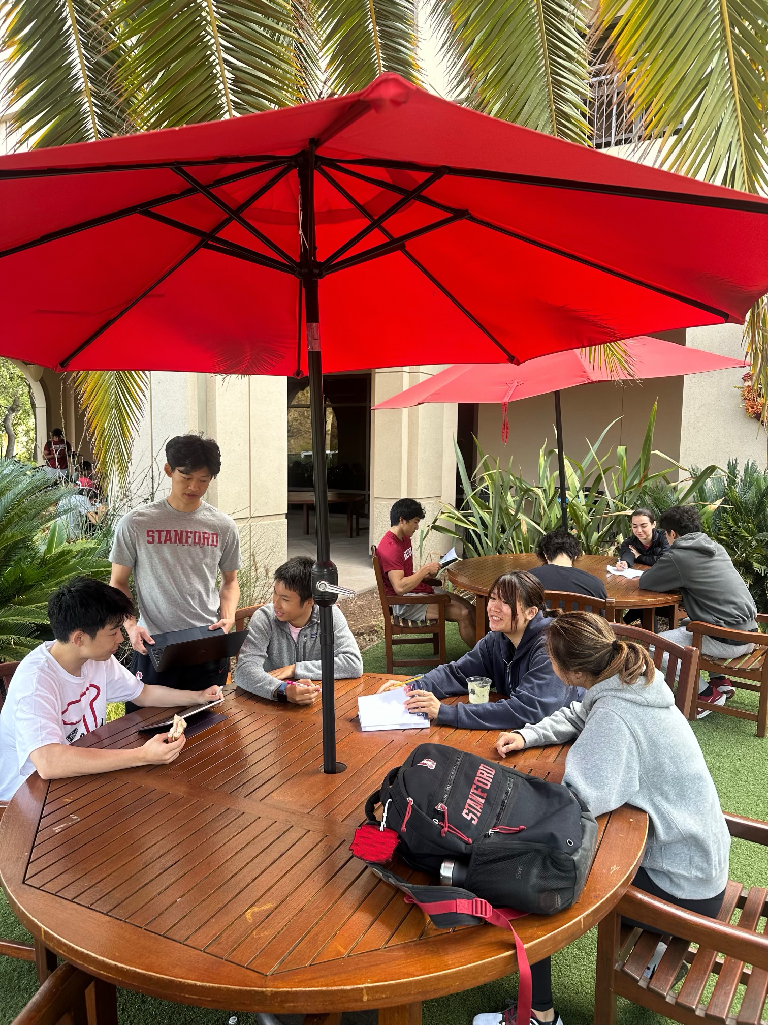
TEST RESULTS:
Stanford Math 21 Students
Enhanced Peer Learning: Students reported improved understanding of complex topics and benefited knowledge through collaboration.
Increased Engagement in a Casual Setting: Students were more comfortable asking for clarification without the pressure of one-on-one interactions.
Structured Problem-Solving: Guided inquiry-based learning helped all groups avoid just answer-checking, promoting deeper understanding and problem-solving confidence
Distracting - Large groups led to off-topic discussions which were counterproductive

Slide 26

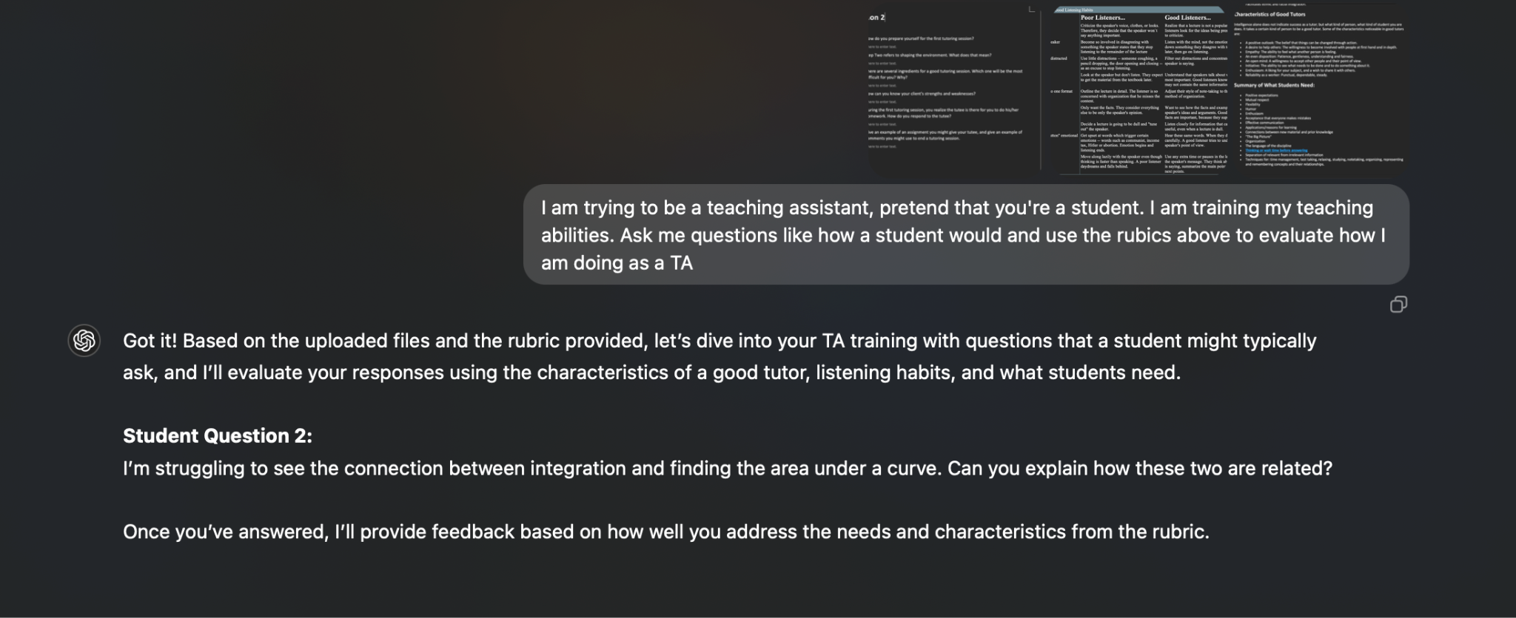

PROTOTYPE 2: AI-powered Training Modules
Use training modules and AI to help prospective TAs prepare for real life scenarios and provide better support to students in need
TAs will find it easier to practice training sessions with an AI chatbot that is readily available to give instant feedback
Concept
Critical Assumption
Format
Written material about how to handle a scenario, then an AI chatbot that simulates that scenario and evaluates skills

Slide 27
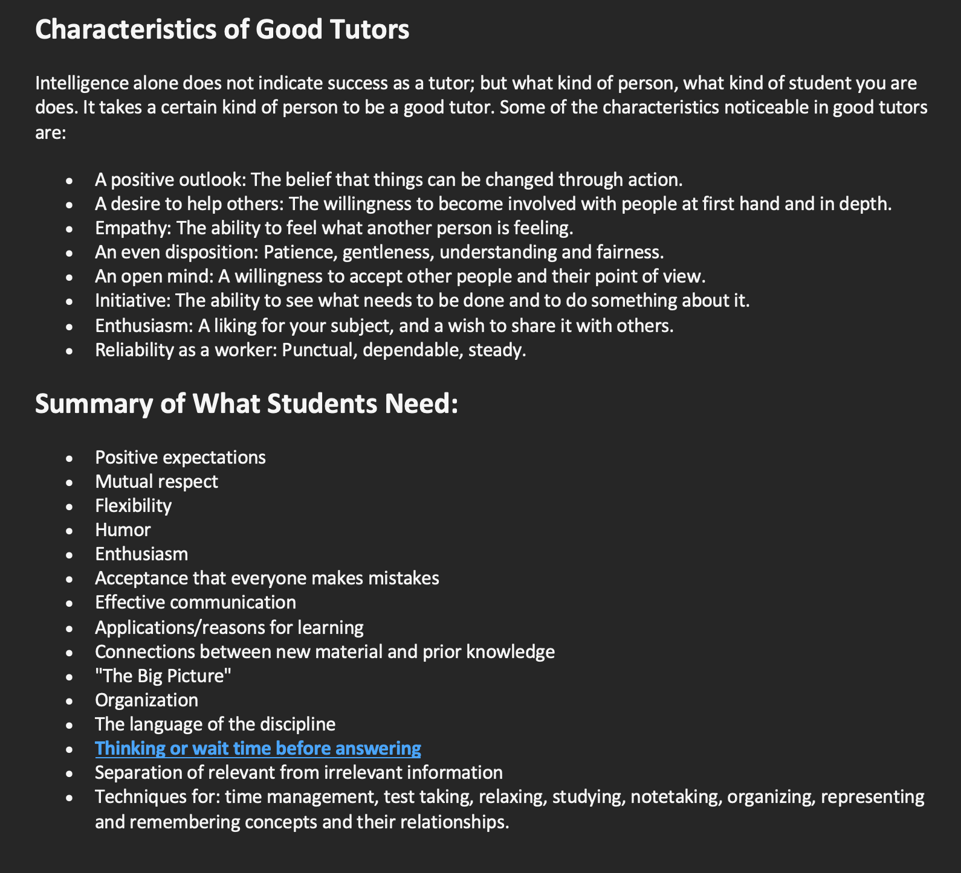


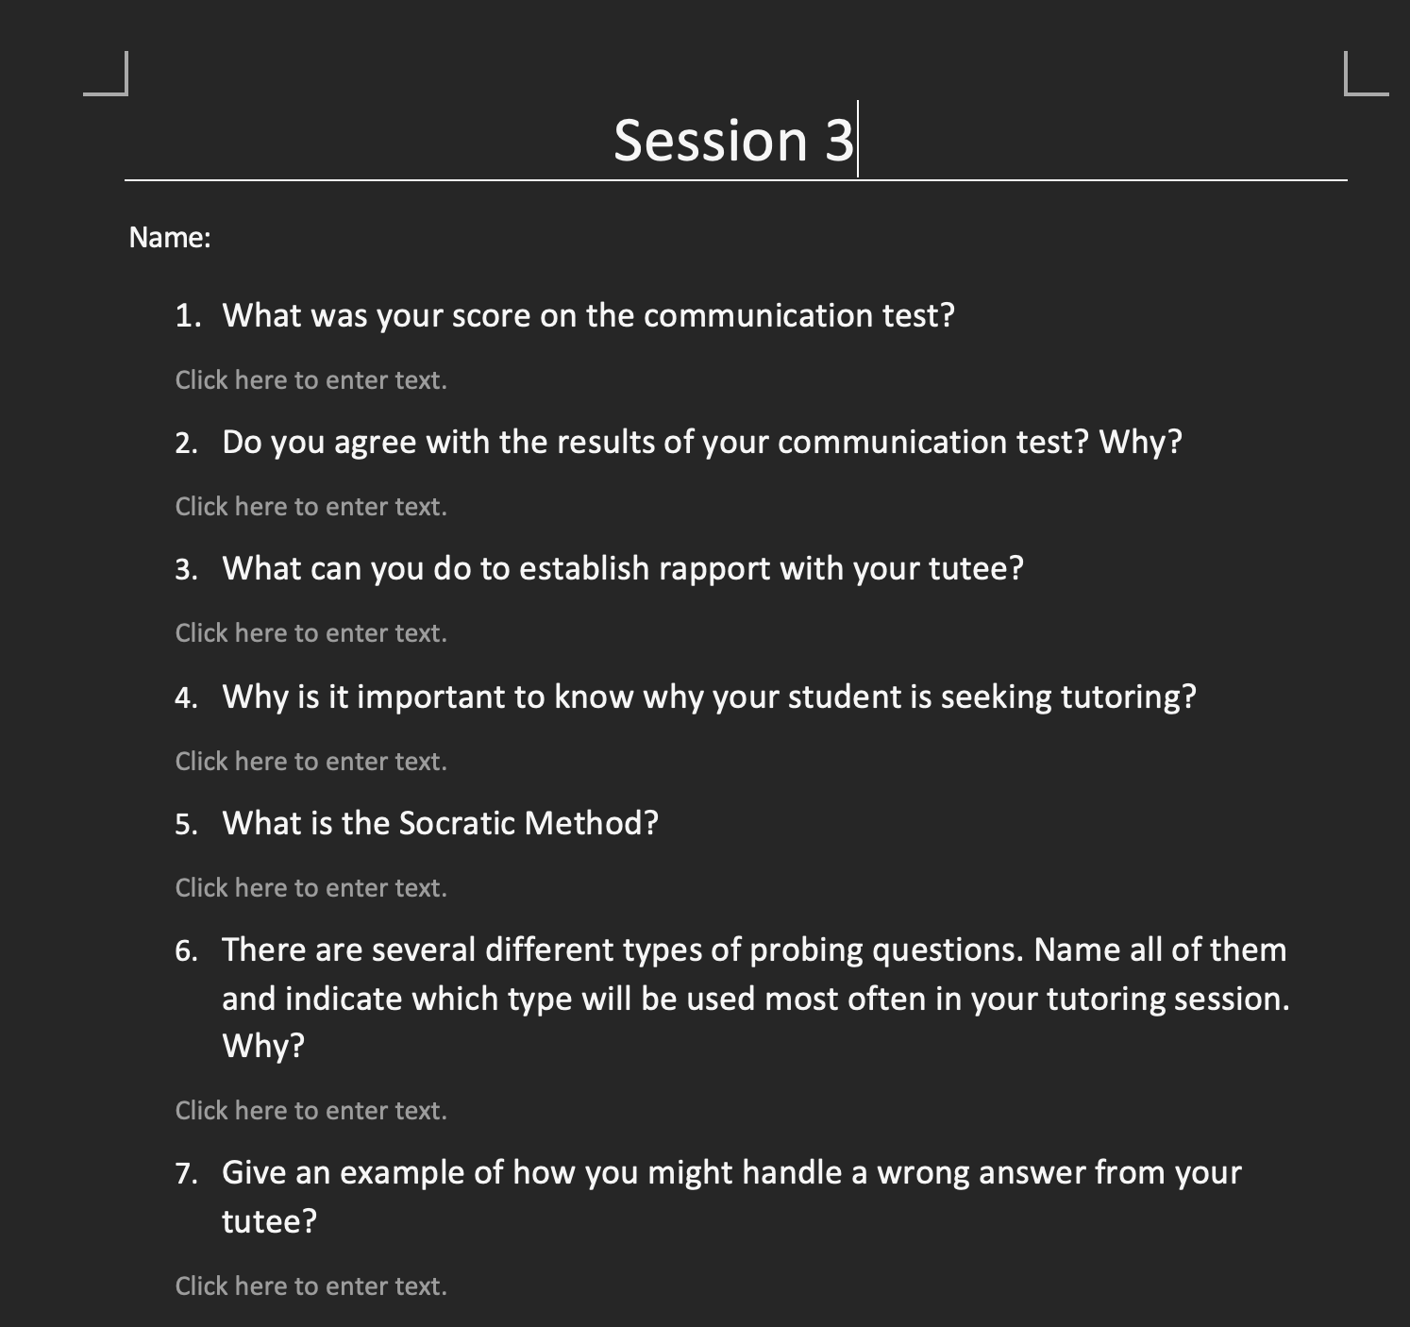
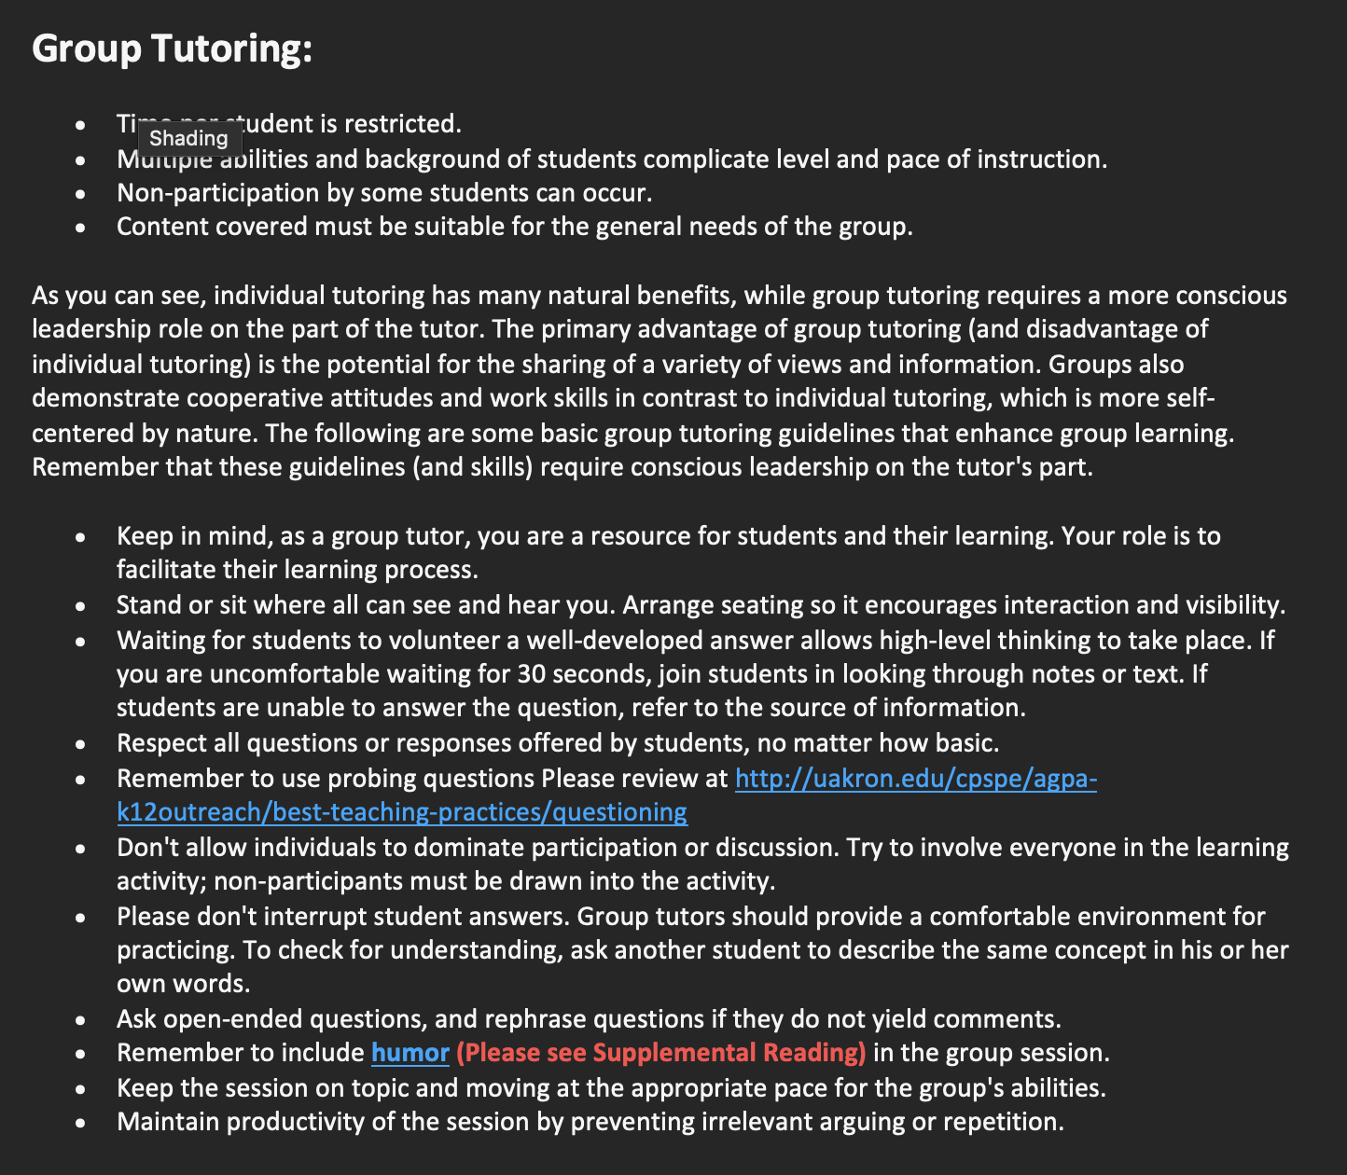
Teaching Assistant Rubric & Module
Training session with user and instant feedback
Feed into AI Chatbot

Slide 28

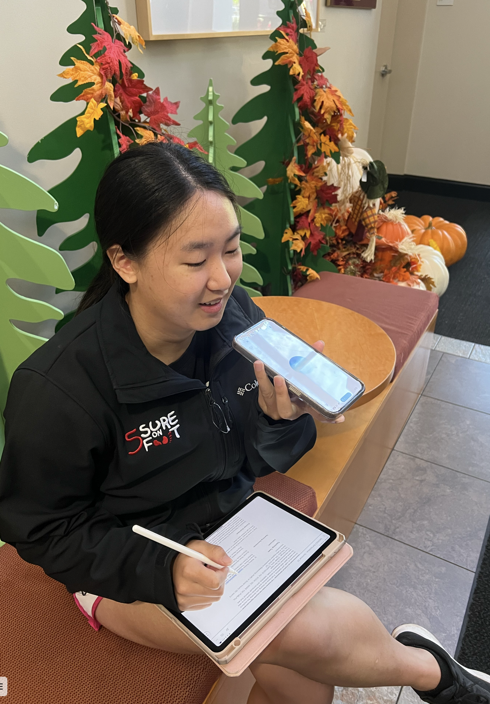
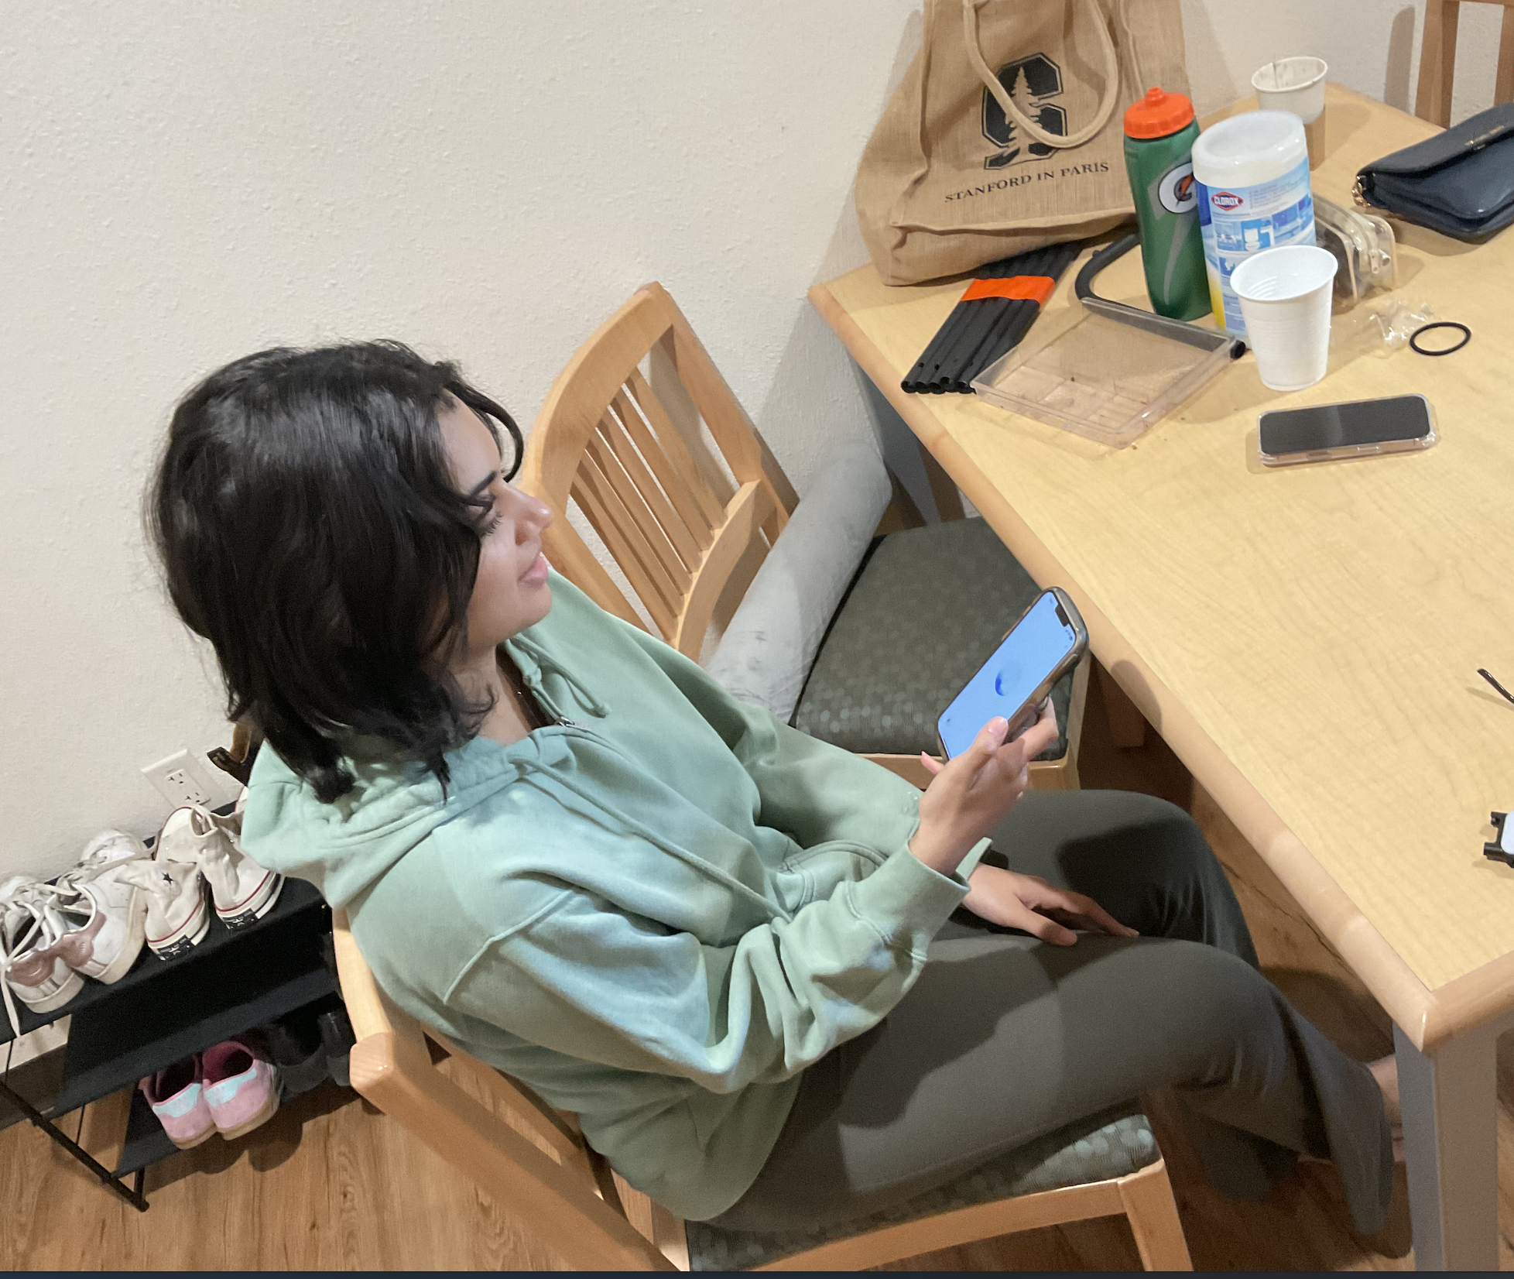
TEST RESULTS: Prospective Stanford Tutor/TA
Subjects
Prospective Stanford CS TA and Hume Tutor looking for ways to practice teaching and helping tutees learn
They were asked to act out a mock TA training session with a GPT voice chatbot (~25min)
The Subjects Liked:
The subject also liked the immediate and constructive feedback after training session and the accessibility of AI chatbot
Suggested Improvements:
Body language and in person dynamics are important to a tutoring session too, so it would be beneficial to have efficient training in that aspect as well

Slide 29



PROTOTYPE 3: PEER TUTORING
An application to match struggling students with student tutors who have taken the class and can work around a busy schedule.
College students want to be tutored by someone who has experience with a class they’re struggling with.
Concept
Critical Assumption
Format
A Google Form with questions about needs for a tutor and schedule, followed by a fake “matches” page

Slide 30
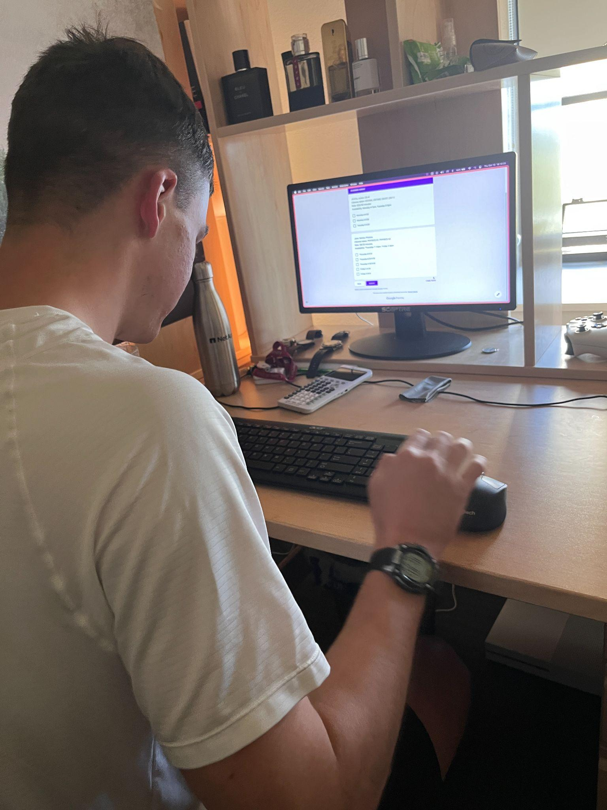
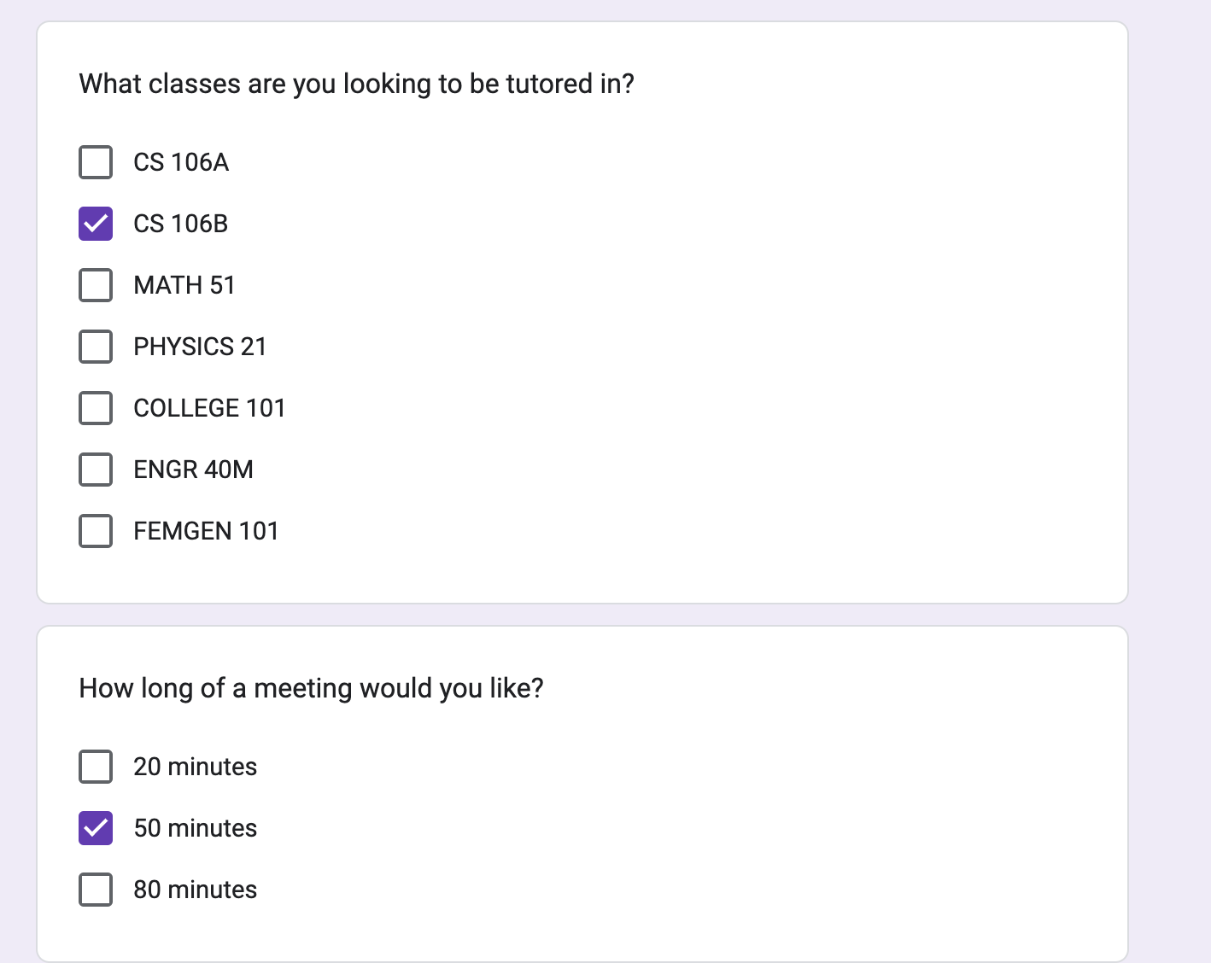
TEST RESULTS
Subject
A Stanford sophomore who has sought out student tutors before.
The Subject Liked:
The ability to fill out a schedule and pick session lengths
Specify which specific classes and content to receive help on
Suggested Improvements:
Would not have paid for a session before seeing each tutor’s grades in relevant classes
Would appreciate a bio for tutors to describe extracurricular qualifications

Slide 31

MAIN TAKEAWAYS
Students want to be taught by people who are familiar with the course, but won’t trust a tutor they don’t know without seeing grades and qualifications
Collaboration between students fosters an exchange of problem-solving strategies and elevates their learning experience but large groups can be distracting at times
For individual learning, an AI chatbot can provide instant feedback and create a back-and-forth with the user, encouraging the flow of ideas

Slide 32
05
WHAT’S NEXT?

Slide 33
OUR BIGGEST SUCCESS: PEER TUTORING
We decided to pursue: a student-tutor matching platform where students can make requests to peer tutors who match their specific needs, allowing students and tutors to work around their own schedules and set their tutoring rates
Ethical Considerations: User safety, data privacy, equity & access, academic integrity
Our solution will serve students who need quick and quality academic support and capable students looking to make money through tutoring

Slide 34
06
APPENDIX

Slide 35

NEW POV #1: “SAM ALTMAN”
How might we redesign a 2000-person lecture to be more engaging and personalized?
How might we ensure that TAs at office hours have time to teach the content rather than simply giving answers?
How might we make student support systems more flexible, addressing everyone's needs without slowing down advanced students?
How might we incentivize tutors to help with the learning process rather than just provide answers?
How might we make lecture content more relevant and applicable to real-world problems to reduce reliance on AI tools?
How might we increase collaboration among students in large lectures to foster community and shared learning responsibility?
How might we reduce the over-reliance on AI tools by improving the accessibility and quality of in-person academic support?
How might we design learning resources that are more interactive and adaptable to individual students’ needs?
How might we encourage students to seek in-person help instead of turning to AI-driven shortcuts?
How might we create an academic culture that values mastery of concepts over quick solutions?
How might we design STEM courses that balance difficulty with support, so students are challenged but not overwhelmed?
How might we introduce peer-assisted study sessions in large classes to promote active, group-based learning?
How might we create transparency and accountability for students who rely heavily on AI tools in their learning process?
We met with “Sam Altman,” a recent UCSB graduate who used AI tools extensively in his learning process. We are surprised to notice that introductory STEM classes at his school were intentionally made difficult enough to discourage people from pursuing specific majors and that the learning resources provided were either scarce, redundant, or irrelevant. We wonder if this means that Sam’s eventual reliance on AI resulted from a lack of personalized help from a school incentivized not to provide any. It would be game-changing to create learning resources that help students seek in-person help to reduce the appeal of cheating with AI.

Slide 36

NEW POV #2: “ADA LOVELACE” (from last week’s interviews)
How might we streamline the hiring process for TAs to reduce bias?
How might we make the TA hiring process more accessible to a diverse range of candidates?
How might we ensure proper training for TAs to increase their effectiveness?
How might we develop a standardized training program for TAs?
How might we prevent tunnel vision and ensure flexibility in the TA selection process?
How might we create a more inclusive and supportive environment for prospective TAs during hiring?e
How might we reduce the time and effort required in the TA hiring process without compromising quality?
How might we use technology to assist in a fair and efficient TA selection process?
How might we ensure continuous feedback and support for TAs during and after their hiring process?
How might we redesign the TA hiring process to include both technical skills and teaching abilities?
How might we make the TA hiring process adaptable to different departments' specific needs?
How might we encourage prospective TAs to apply by reducing unnecessary hiring hurdles?
How might we eliminate bias in interviews and ensure diverse perspectives in the hiring panel?
How might we create a mentorship system for new TAs to learn and adapt more effectively?
We met with “Ada Lovelace,” a full-time TA and Edtech Researcher at Stanford University, who has gone through the extensive process of becoming a TA. We were surprised to notice how long and rigorous the hiring process is, yet it lacks proper training for those selected to become TAs. We wonder if this means that many potential candidates are excluded because they don't fit into the narrow criteria required to complete the process. It would be game-changing to create a standardized system to prevent bias in hiring TAs and streamline the process, giving more people the opportunity to receive proper training and teach in a less rigid way.

Slide 37
NEW POV #3: “JAMES GOSLING”
We met with “James Gosling,” a former high school English teacher with 20 years of experience, who also taught world history at both private universities and community colleges before transitioning into freelance tutoring and educational counseling. We were surprised to notice how restricted he felt by the lack of academic freedom in traditional institutions, where bureaucracy and rigid expectations limited his ability to teach effectively and connect with students. We wonder if this means that many educators, especially junior faculty, are stifled by these institutional constraints, preventing them from exploring more dynamic and impactful teaching methods. It would be game-changing to create an environment that promotes true academic freedom, allowing educators the liberty to teach in ways that foster deeper student engagement and accountability, without being bound by outdated structures and expectations.
How might we streamline the hiring process for TAs to reduce bias?
How might we make the TA hiring process more accessible to a diverse range of candidates?
How might we ensure proper training for TAs to increase their effectiveness?
How might we develop a standardized training program for TAs?
How might we prevent tunnel vision and ensure flexibility in the TA selection process?
How might we create a more inclusive and supportive environment for prospective TAs during hiring?
How might we reduce the time and effort required in the TA hiring process without compromising quality?
How might we use technology to assist in a fair and efficient TA selection process?
How might we ensure continuous feedback and support for TAs during and after their hiring process?
How might we redesign the TA hiring process to include both technical skills and teaching abilities?
How might we make the TA hiring process adaptable to different departments' specific needs?
How might we encourage prospective TAs to apply by reducing unnecessary hiring hurdles?
How might we eliminate bias in interviews and ensure diverse perspectives in the hiring panel?
How might we create a mentorship system for new TAs to learn and adapt more effectively?

Slide 38
Brainstorm Solution #1
Learning Progress Tracker: App that tracks a student’s learning gaps and suggests questions based on what they don’t understand, which TAs can review.
TA “Teaching Game”: Gamify office hours, where TAs guide students through mini-learning challenges before they get direct answers.
TA Skill Workshops: Monthly workshops for TAs to improve teaching methods, focusing on leading conceptual discussions over quick answers.
“Office Hour Bot”: An AI-powered assistant that helps answer basic questions, allowing TAs to focus on deeper teaching.
How might we ensure that TAs at office hours have time to teach the content rather than simply giving answers?
Adaptive Learning Session App: Tailored, AI-driven learning sessions with TAs based on the student’s progress and areas of confusion.
Real-time Q&A Whiteboard: A collaborative digital whiteboard where students post questions and TAs answer by breaking down concepts for group learning.
TA Skill Workshops: Monthly workshops for TAs to improve teaching methods, focusing on leading conceptual discussions over quick answers.
Interactive Concept Builder: Software where students build visual concept maps before meeting with TAs, helping TAs identify areas for instruction.

Slide 39
Brainstorm Solution #2
Interactive Concept Builder: Software where students build visual concept maps before meeting with TAs, helping TAs identify areas for instruction.
Real-Time Feedback App: An app where students can give anonymous feedback on TAs’ teaching methods during office hours for real-time improvement.
How might we ensure proper training for TAs to increase their effectiveness?
Peer Review System: TAs review each other’s teaching methods and provide feedback to improve.
AI TA Training Advisor: AI-driven platform that analyzes a TA’s interactions and suggests improvements in clarity, pacing, and engagement.
TA Training Simulator: Create an AI-powered simulator where TAs practice answering common student questions in real-time.
TA Teaching Toolkit: Provide TAs with digital teaching resources like slides, concept maps, and interactive exercises tailored to the course.

Slide 40
Brainstorm Solution #3
Peer Review System: TAs review each other’s teaching methods and provide feedback to improve.
“Smart Tutor” Matching Algorithm: AI-driven algorithm that learns students’ preferences and suggests tutors based on teaching style and past success rates.
• Automatic Scheduling: Syncs tutor availability with students’ calendars, proposing the best times based on mutual openings.
Real-Time Availability Map: A live map showing nearby tutors available now, allowing instant booking for immediate help.
How might we make the process of finding and booking a tutor as easy and seamless as booking an Uber?
Dynamic Pricing: Surge pricing for high-demand times or subjects, offering flexibility for both tutors and students.
Tutor Profiles with Ratings: Profiles with ratings, reviews, and specialties displayed upfront, making it easy to choose a tutor like selecting a ride tier.
TA Skill Workshops: Monthly workshops for TAs to improve teaching methods, focusing on leading conceptual discussions over quick answers.
Instant Messaging & Video Integration: In-app messaging and video options for immediate sessions after booking without external tools.

Slide 41
Assumptions: Study group
Students will prefer collaborative group-based learning to traditional one-on-one TA sessions.
Grouping students based on similar topics of confusion will enhance the relevance and depth of the learning experience.
More advanced students will benefit from explaining concepts to their peers, reinforcing their understanding.
Structured problem-solving will lead to better critical thinking skills compared to direct answer-providing methods.
Students will feel more motivated and less isolated when working in groups on difficult topics.
Peer interactions will help clarify concepts that students might find intimidating to ask the TA directly.
Checkpoints throughout the session will help students stay on track and provide a sense of accomplishment.
Using a collaborative digital whiteboard will make the group learning process more interactive and accessible.
Students will appreciate receiving recordings of the sessions to review the discussed concepts, reinforcing learning.
Inquiry-based facilitation by the TA will lead to deeper learning compared to straightforward explanations.
Key Assumption:
Grouping students based on similar topics of confusion will enhance the relevance and depth of the learning experience

Slide 42
Assumptions: Uber like app
Students will appreciate the convenience of finding and booking tutors instantly, similar to booking an Uber rides
Students are more likely to choose a tutor based on high ratings and detailed reviews, trusting the feedback from other users
Tutors will be motivated to offer their services on Tutti due to the ease of setting up availability and secure, automated payments.
Students will value having multiple session types available, including on-demand, one-on-one, and group tutoring.
Geolocation-based tutor matching will appeal to students who prefer in-person sessions, especially for urgent academic needs.
The AI-driven matching algorithm will effectively connect students with tutors that align with their learning needs and preferences.
A flexible payment system within the app will encourage more students to book tutoring sessions without concerns over payment processing.
Push notifications and in-app messaging will be essential for keeping students and tutors organized and informed about sessions and expectations.
Students will appreciate being able to set academic goals and track their learning progress over time, leading to more meaningful engagement with the app.
The rating and review system will create a sense of accountability, driving tutors to maintain high-quality sessions to receive better visibility.
Key Assumption:
Students will appreciate the convenience of finding and booking tutors instantly, similar to booking an Uber rides

Slide 43
Assumptions: Training Module
TAs will benefit from structured training on managing student expectations and conflict resolution, especially if they are new to teaching roles.
Establishing clear expectations at the beginning of a course will help minimize confusion and improve student satisfaction.
TAs will feel more confident in their role if they practice setting boundaries and communicating their scope of assistance through role-play or simulated sessions.
Practical training on handling conflicting student demands will empower TAs to manage requests without feeling overwhelmed.
Teaching TAs effective conflict resolution techniques will lead to more positive interactions between students and TAs, contributing to a supportive learning environment.
Culturally sensitive training will enable TAs to handle conflicts arising from differences in communication styles, creating an inclusive classroom.
TAs who understand how to deliver constructive feedback will help students feel encouraged rather than discouraged by their evaluations.
Role-playing conflict and feedback scenarios will improve TAs' ability to handle real-life student interactions diplomatically and confidently.
The use of pre-made tools like grading templates and feedback rubrics will ensure consistency across different TAs and reduce ambiguity for students.
Ongoing workshops and webinars will help TAs continuously improve their skills in conflict resolution and managing student expectations, ensuring continuous professional development.
Key Assumption:
TAs will benefit from structured training on managing student expectations and conflict resolution, especially if they are new to teaching roles.

